Slide 1

A Masterclass in Reproducibility
Warwick University – November 2020
Dr Tom August

Slide 2
Introductions
01

Slide 3
Introductions
Computational Ecologist at the Centre for Ecology and Hydrology
10 years practical experience in reproducible research

Slide 4
Course Aims
Know what reproducibility is
Know why reproducibility is important
Know how to implement reproducibility in your own work
You wont be an expert in reproducibility
This is a course about reproducibility not about R

Slide 5
Timetable

Slide 6



Course preparation

Slide 7
Course materials
Slides
Practical's
Other materials
All these are available online and we download them later
Much of this material is reproduced, using resources shared openly by others, notably Karl Broman, Coding Club, Hadley Wickham

Slide 8
Course style
There is going to be a mix of slides and practical
Things will start slide heavy and end practical heavy
This is informal, if you have a question put it in the chat
There are no stupid questions
You can catch me in the practical sessions
Practicals are designed to help you learn
Work at your own pace, if you don’t finish it doesn’t matter
If you finish early help each other out
I’m hear to teach, not to solve IT issues
There is only one of me

Slide 9
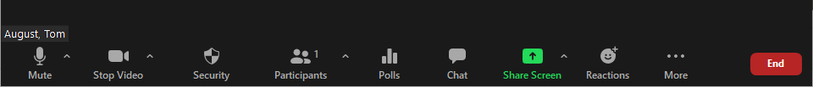
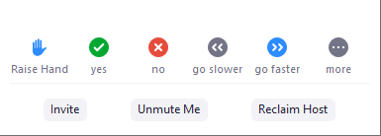
Introduction to Zoom
Notes:
Demonstrate how it is done
60 seconds to reproduce
What made it hard to reproduce
What could we have done to make it easier to reproduce?
These are themes we are going to come back to time and again
9

Slide 10
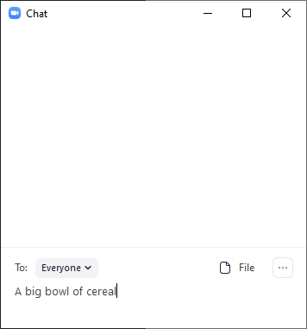
Introduction to Zoom
Notes:
Demonstrate how it is done
60 seconds to reproduce
What made it hard to reproduce
What could we have done to make it easier to reproduce?
These are themes we are going to come back to time and again
10

Slide 11
Getting all the course materials
Open Rstudio
In the console type (I’ll put this in the chat window)
install.packages('usethis’)
usethis::use_course('https://github.com/AugustT/reproducibility_masterclass/raw/master/master.zip')
Agree to the destination (unless you really don’t want to!)
Agree to remove the zip file
Raise your hand once you’re done

Slide 12
Setting the scene
02

Slide 13
Some definitions
Reproducibility: A study is reproducible if you can take the original data and the computer code used to analyze the data and reproduce all of the numerical findings from the study.
Replicability: This is the act of repeating an entire study, independently of the original investigator without the use of original data (but generally using the same methods).
Other terms: Repeatable, Reusable, Correct

Slide 14
What are the hallmarks of reproducible research?
Analyses that are well documented
Files that are well organised
Processes that are coded, rather than carried out manually
Data that is easy to find and access
Edits and versions are easy to track

Slide 15
Why is reproducibility a good thing?
For us?
Your most frequent collaborator is your past self
Your work is more likely to be used by others if it is reproducible
You are more likely to avoid errors
You will save time in the long run (“Can you re-run this?”)
For ‘science’
It is easier to trust studies that are reproducible
Methods can be shared for effectively
Speeds up the scientific process

Slide 16
Why is reproducibility a good thing?
“To much fanfare, the journal Science published promising developments in stem cell research only to learn months later that the findings were bogus (1). Lancet editors retracted a paper on oral cancer when the editors learned that the researchers had fabricated their data (2). The New England Journal of Medicine published a statement of concern on a drug toxicity study when evidence suggested that the authors had withheld important adverse outcomes (3). Incidents of authors who have not disclosed potential conflicts of interest have prompted JAMA to reinforce its disclosure policies (4–6). Here at Annals, we retracted an article after learning that the lead author had fabricated the data. (7–9)” – Laine et al 2007

Slide 17
A reproducibility crisis
https://www.youtube.com/watch?v=42QuXLucH3Q

Slide 18
How do we make our research reproducible?
Order files and folders and track your edits
Git and Github
Code everything you do
R, Rstudio
Document as you go
Code commenting, Rmarkdown
Make your code reusable
R functions, R packages, Rmarkdown
Make your results easy to find
Shiny

Slide 19
Files and folders
03

Slide 20
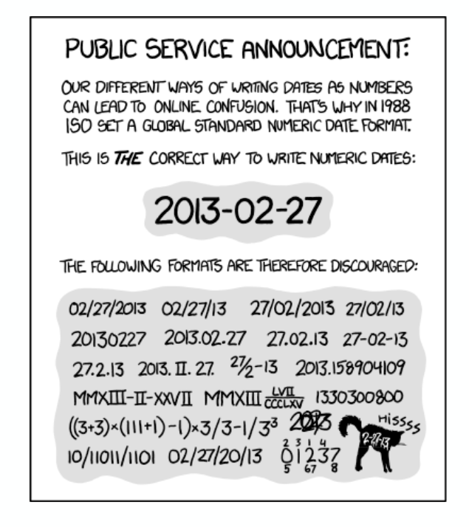
Good practise for organisation
Have one folder per project
Organise your files into folders. Typically I have:
Data | Code | Results
Name files clearly, they should be human-readable:
IJKGG.csv | Data.csv | Bat_data_2018.csv
Use plain text files where possible, avoid proprietary formats
Bat_data_2018.xlsx | Bat_data_2018.csv
Add dates to file names, especially data, think about order
Group_data_ 20190111.csv
Backup your work
Be consistent
XKCD

Slide 21
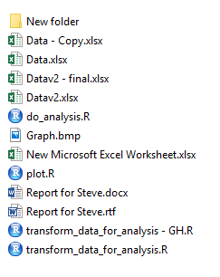
Practical
2_Files_and_folders\my research
Organise your files into folders
Name files clearly
Use plain text files where possible
Add dates to file names, especially data
Be consistent
5 minutes

Slide 22
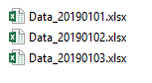
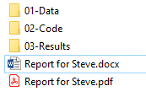
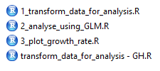
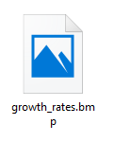
Practical

Slide 23
Coding etiquette
04

Slide 24
Coding etiquette
Code should be human readable
You want it to make self to others and yourself
Reading code should not give you a headache
It is worth taking a little extra time to make it easier to understand
A good resource: Hadley Wickham's R Style Guide
But… there are a number of different style guides out there and they do disagree quite a lot.

Slide 25
Coding etiquette
BAD
first_day_of_the_month
DayOne
dayone
djm1
Variables store data and should be nouns [bat_counts], functions do things and should be verbs [mean].
Names should be short and descriptive with ‘_’ or CamelCase used to separate words in names.
You will find conflicting advise online and between programmers. Hadley Wickham doesn’t like CamelCase:
GOOD
day_one
day_1

Slide 26
Coding etiquette
Use spaces in your code to make it easy to read and understand. You are not going to run out of space so don’t cram everything together.
average<-mean(feet/12+inches,na.rm=TRUE)
average <- mean(feet / 12 + inches, na.rm = TRUE)

Slide 27
Coding etiquette
When using loops or if statements in R You can end up with ‘nested’ code. Using indentation is key to making this easy to read.
if (y == 0) {
log(x)
} else {
if(x == 1){
y ^ x
} else {
x ^ y
}
}
if (y == 0) {
log(x)
} else {
if(x == 1){
y ^ x
} else {
x ^ y
}
}

Slide 28
Coding etiquette
Avoid long lines, that can make it harder to read your code.
My_data <- read.csv(path = ‘mydata.csv’, header = TRUE, sep = ‘,’, stringsAsFactors = FALSE)
My_data <- read.csv(path = ‘mydata.csv’,
header = TRUE,
sep = ‘,’,
stringsAsFactors = FALSE)

Slide 29
Coding etiquette
Clearly document what your code does, and break it into sections:
# Comments start with a ‘#’ and are ignored
# when you run your code
X <- 1:10
# Average the values in X
mean(X)

Slide 30
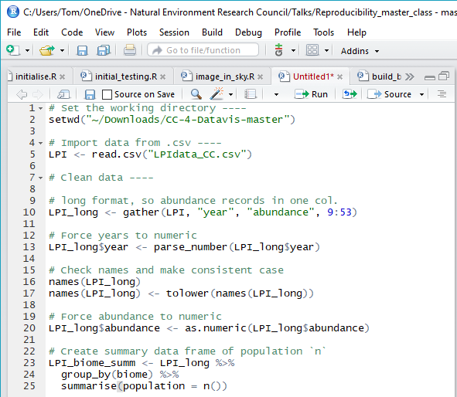
Coding etiquette
Clearly document what your code does.
How much is enough?
# Analysis of 2019 finances
# Tom August
# 2019-01-05
# 1. Load libraries ----
…
# 2. Load data ----
…
# 3. Reformat data ----
…
# 10. Save results ----
…

Slide 31
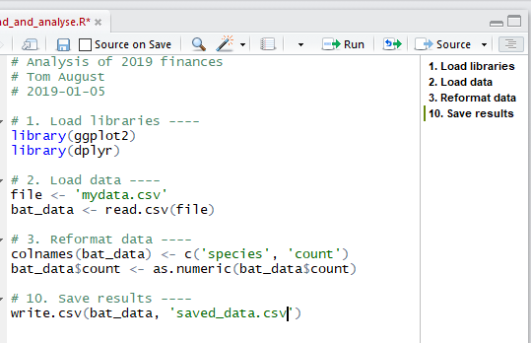
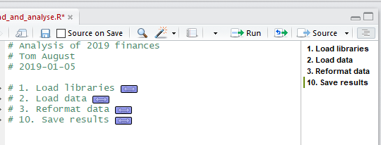
Coding etiquette
Rstudio has some features that can help you to keep organised
Sections

Slide 32
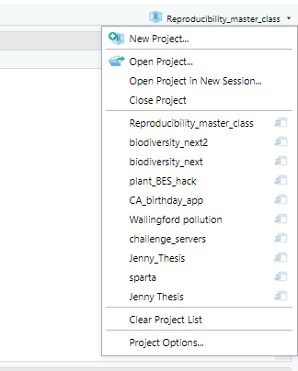
Coding etiquette
Rstudio has some features that can help you to keep organised
Projects
R has a strong bond to the idea of working directories. The solution is to use R Studio projects, don’t set the working directory manually in R

Slide 33
Cheatsheets
3_Code_etiquette/Rstudio_cheatsheet.pdf

Slide 34
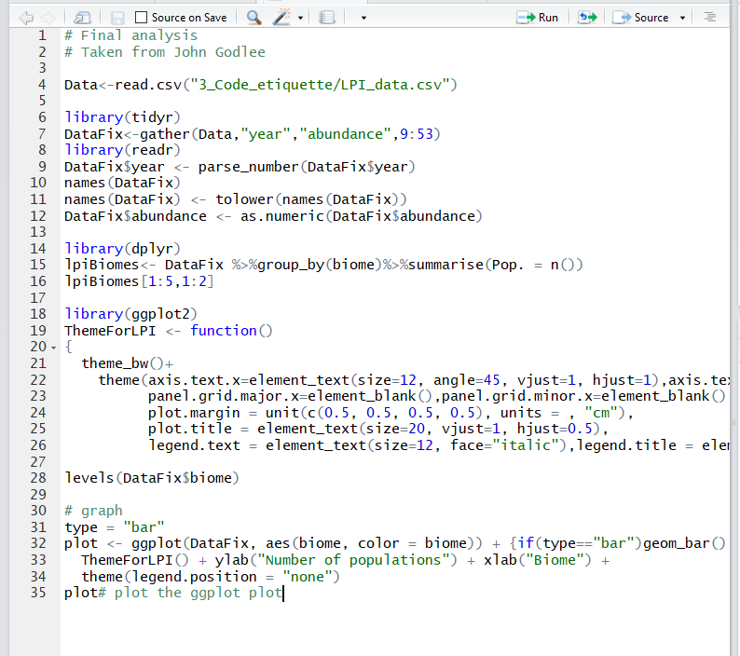
Practical
3_Code_etiquette\bad_script.R
Appropriate names
Spacing
Descriptive comments
Ordered sections
Avoid long lines
10 minutes

Slide 35
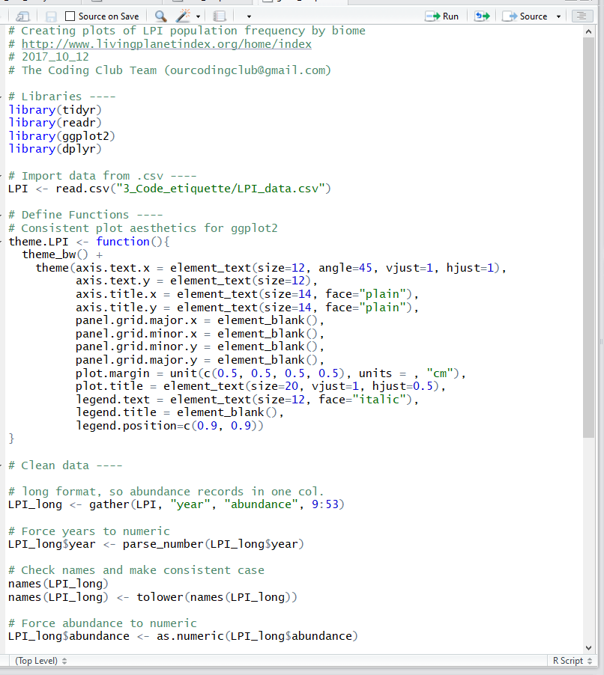
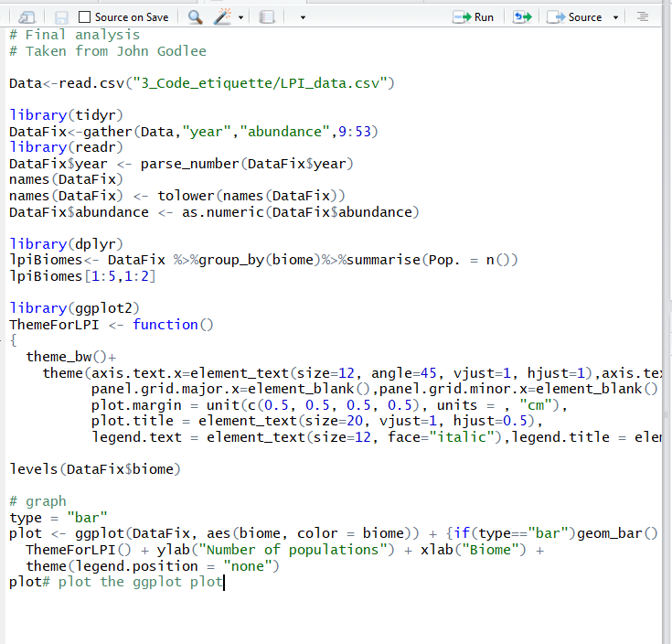

Slide 36
Functions, packages
05

Slide 37
Functions
Functions are R commands that do things
mean(), read.csv(), plot(), c()
Functions let you share functionality with others
It reduces the length of your scripts
They are faster
They will make you write better code
They are easier to share and will run consistently, making them more reproducible

Slide 38
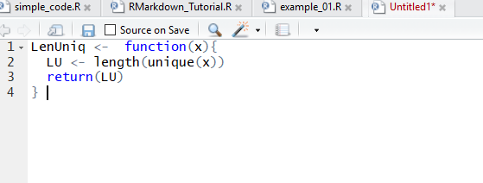
Functions
Name
Arguments
Returned object

Slide 39
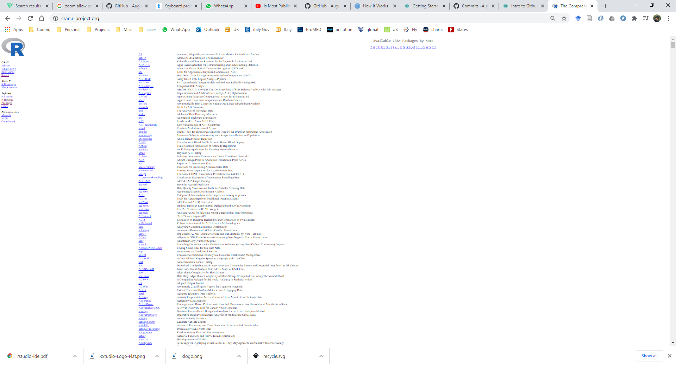
Packages
Packages are collections of R functions that are connected by a common theme
They are easy to share
They are well documented, and often contain ‘vignettes’
‘Published’ packages are put on CRAN
Packages can also be shared via GitHub
Packages are not as hard to write as you might think
Having an R packages can help your reputation as a reproducible researcher
https://hilaryparker.com/2014/04/29/writing-an-r-package-from-scratch/

Slide 40
Unit tests
“UNIT TESTING is a level of software testing where individual units/ components of a software are tested. The purpose is to validate that each unit of the software performs as designed. A unit is the smallest testable part of any software. It usually has one or a few inputs and usually a single output.” - Google
How do you know your code works today, the same way as yesterday?
How do you know Hadley hasn’t broken your package?
How do you know if you need to make updates for the latest version of R?
Answer: Unit tests
http://r-pkgs.had.co.nz/tests.html

Slide 41
Licenses
I share an R package online. You want to use it in your research. Are you allowed to do that? Do you need to credit me?
Licenses dictate what you can and cannot do
The ensure people get credit
They protect your work financially
They can restrict what people can do with your code

Slide 42
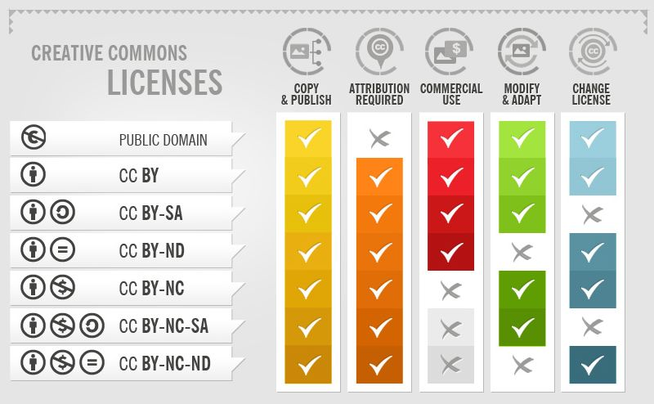
Licenses

Slide 43
RMArkdown
05

Slide 44
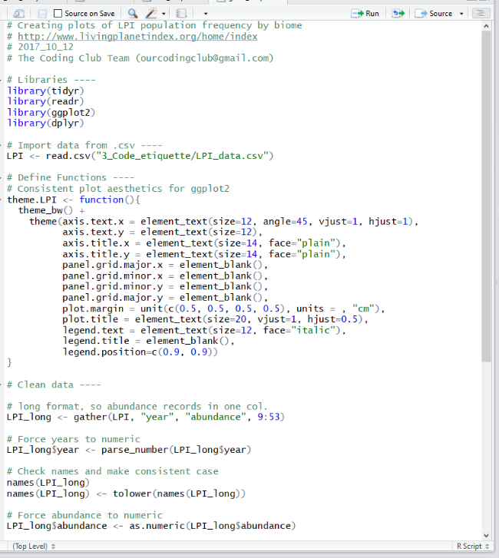

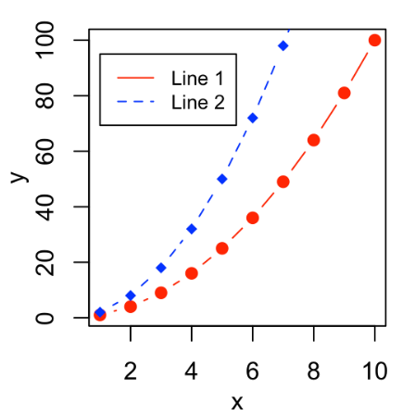
Creating reproducible documents
How do you share your code once complete?
Code
Figures
Documentation

Slide 45
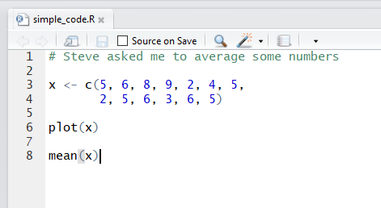
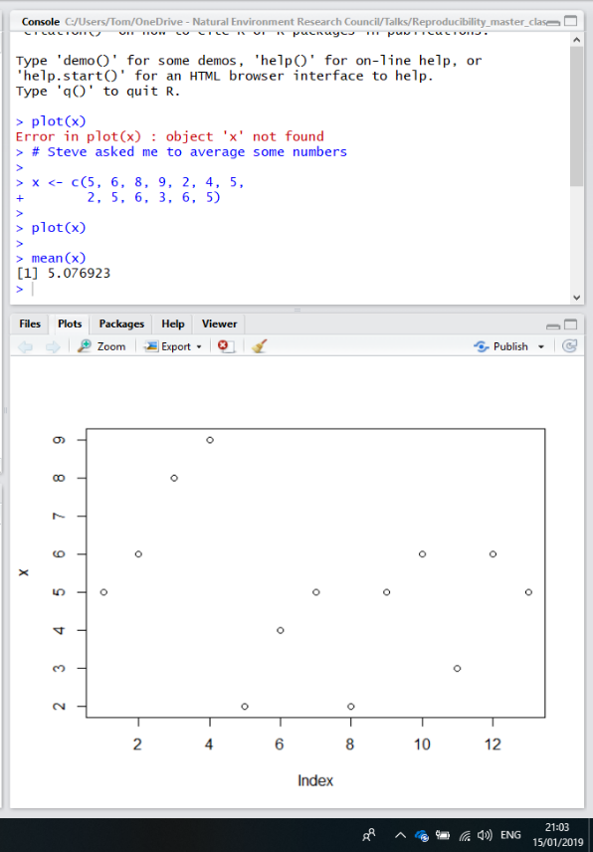
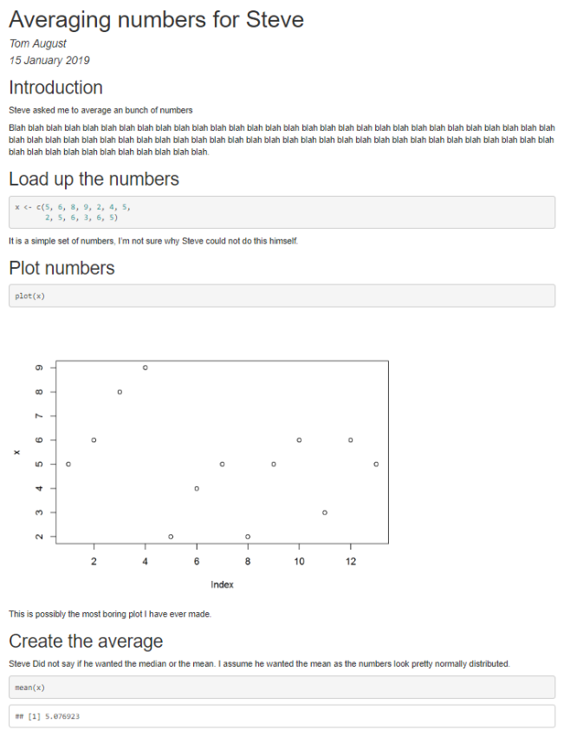
Creating reproducible documents

Slide 46
Creating reproducible documents
What are the advantages of R Markdown?
Ensure your work can be reproduced
Document your code as you go
Make edits and re-run your analysis, this can save a LOT of time
Enable others to re-use or change your work
Keeps code, documentation and results all in one place
It is fast becoming the new ‘norm’

Slide 47
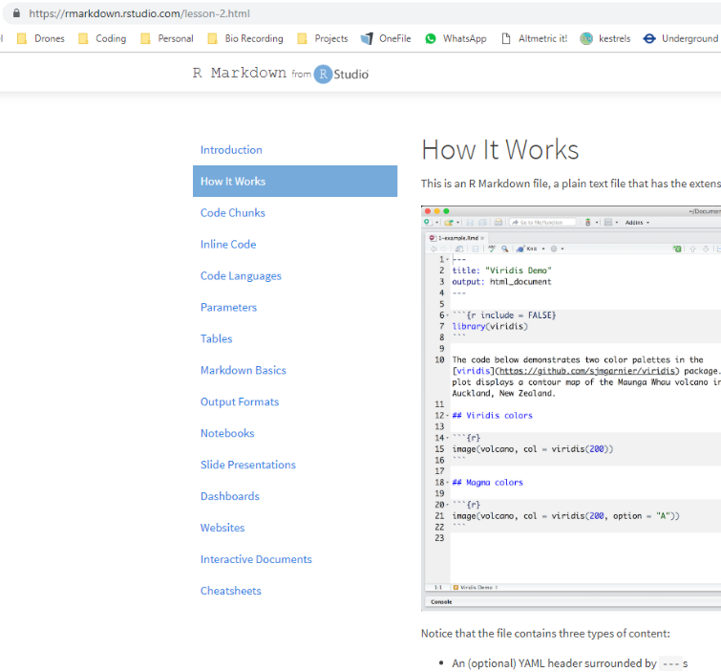
https://rmarkdown.rstudio.com/lesson-2.html
Work through the tutorial from ‘How it works’ to ‘Notebooks’
You don’t need to download the files, I have placed them in you Rstudio project already:
4_R_Markdown\Tutorial_files
20 Minutes

Slide 48
Cheatsheets
4_R_Markdown/R_markdown_cheatsheet.pdf

Slide 49
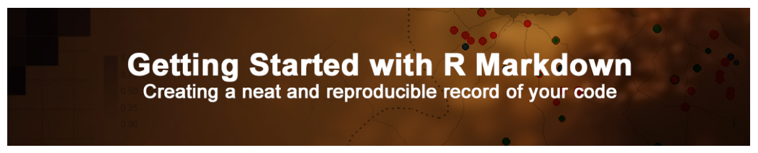
Convert a script to R markdown
Walk-through
Create a fresh R markdown document in R
Load up an R script to convert to R markdown
Follow ‘ourcodingclub’ tutorial
https://ourcodingclub.github.io/tutorials/rmarkdown/#identify
30 minutes

Slide 50
Git and github
06

Slide 51
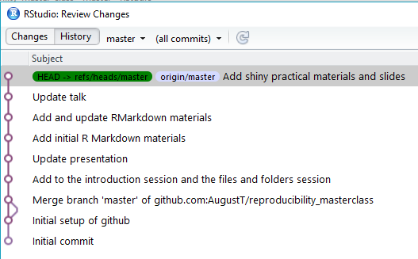
Version Control
Track changes to files
No more need for numbering your files
My_important_data.csv
My_important_data2.csv
My_important_data3.csv
My_important_data4.csv
‘This was working a couple of days ago…’
A Facebook timeline for your code
Named after Linus Torvalds

Slide 52

Version Control
Have you ever had to merge multiple comments to a document?
Tracking in Git makes merging comments easy
Github
Like Facebook, for programmes
… and a bit like dropbox
… and a bit like Google docs
Github makes code truly open
You can view all of the code and all of the history

Slide 53
Version Control
PULL
PUSH
PULL
PUSH
MERGE
Commit
Commit
Tom’s PC
Steve’s PC

Slide 54
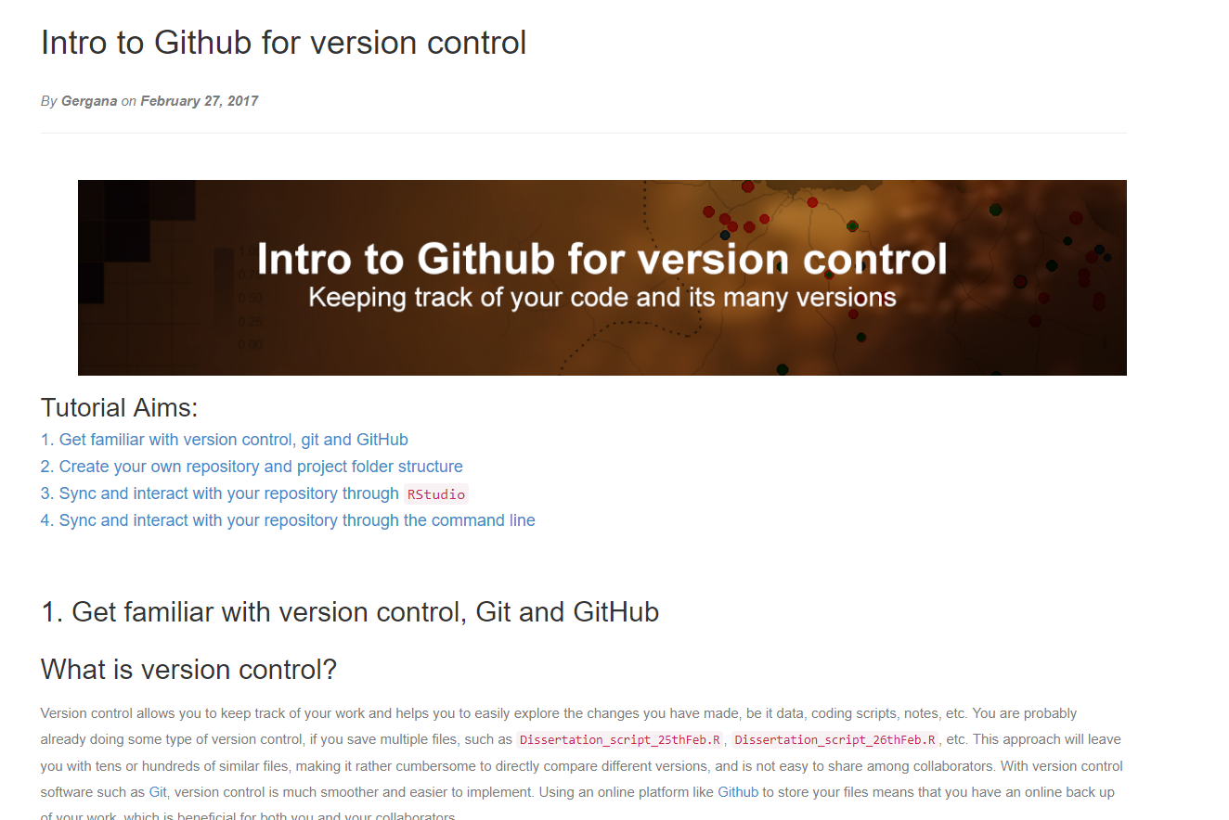
OurCodingClub > Tutorials > Github https://ourcodingclub.github.io/tutorials/git/

Slide 55
Interactive Viz using Shiny
07

Slide 56


How do you share your work once it is complete?
Papers
Presentations
Poster
Tweet
Code on Github
R-package on CRAN

Slide 57
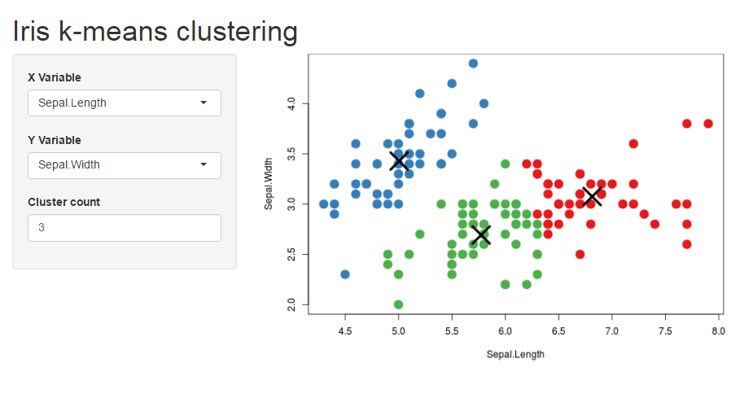
R shiny
Allows others to explore your data, or even use your methods, with out the need to know how to use R

Slide 58
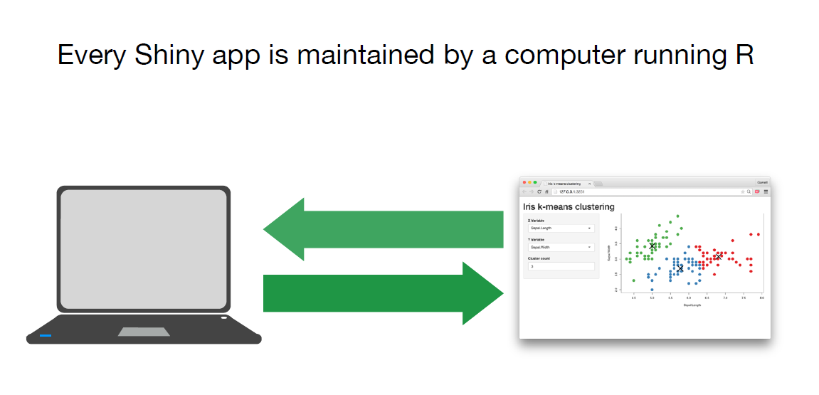
How does it work?
Server.R
UI.R

Slide 59
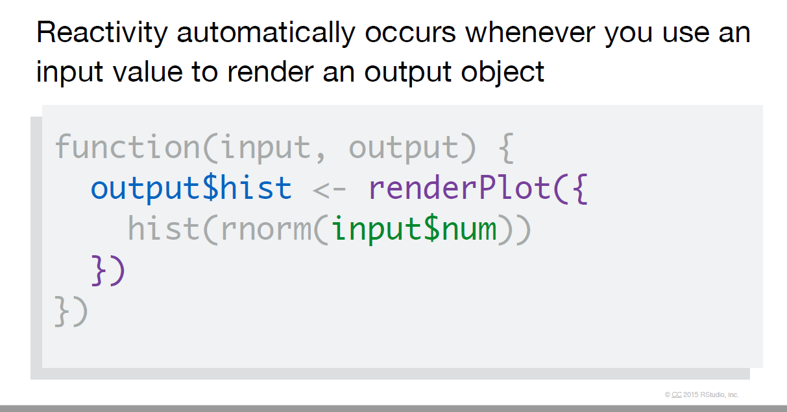
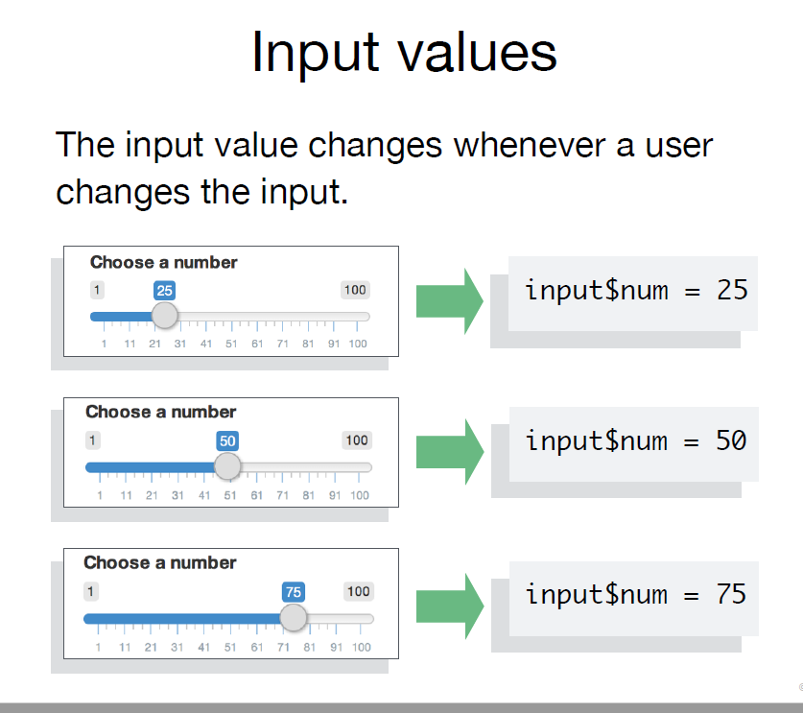
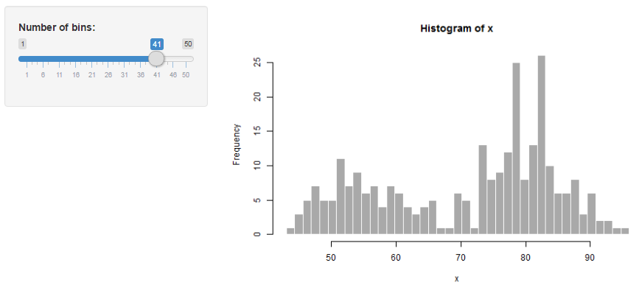
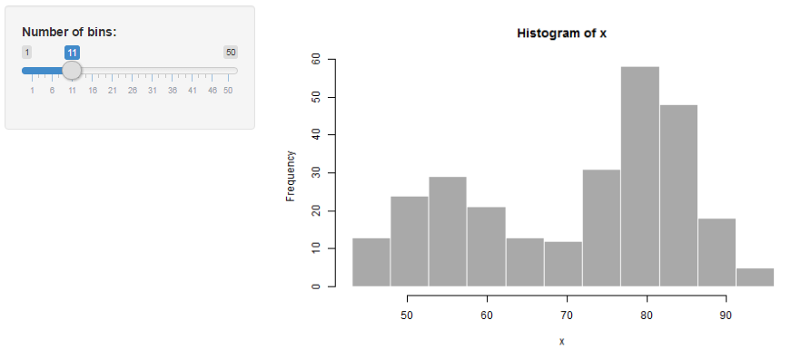
How does it work?

Slide 60
Examples
Shiny Gallery
User inputs define graph http://shiny.rstudio.com/gallery/kmeans-example.html
There are a range of widgets: http://shiny.rstudio.com/gallery/widget-gallery.html
Or with Google charts: http://shiny.rstudio.com/gallery/movie-explorer.html
Maps can be done ++ : http://shiny.rstudio.com/gallery/superzip-example.html

Slide 61
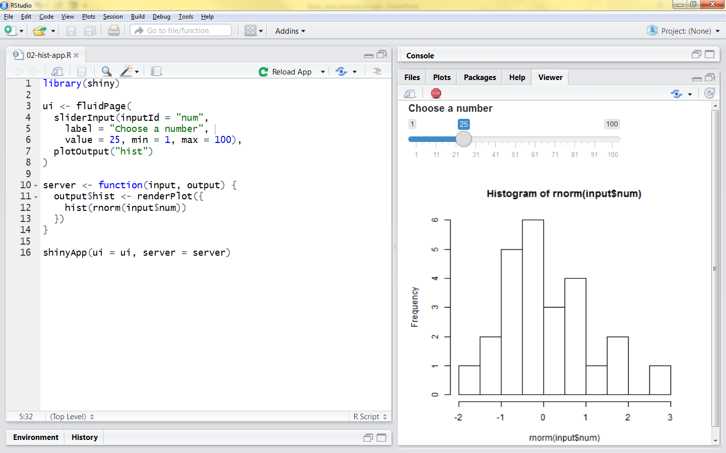
How do I do it?

Slide 62
Cheatsheets
6_shiny/shiny_cheatsheet.pdf

Slide 63
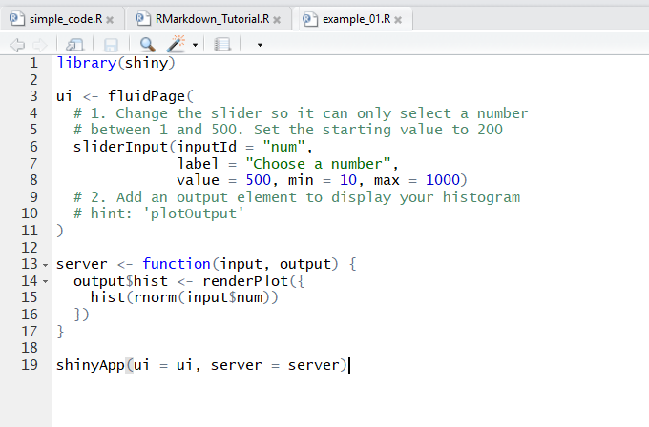
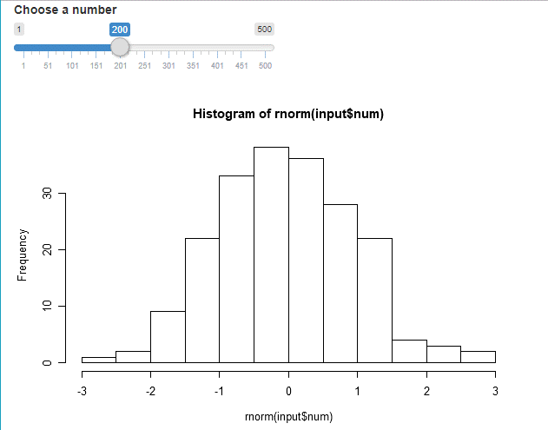
Practical - Walkthrough
6_Shiny/code/example_01.R

Slide 64
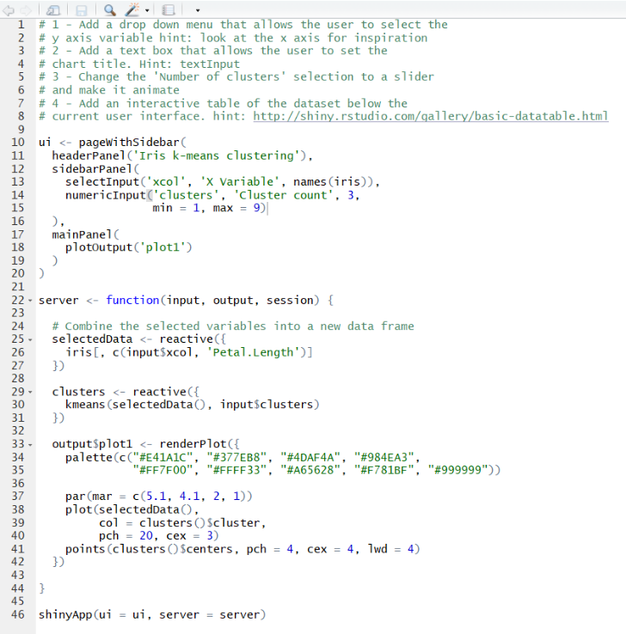
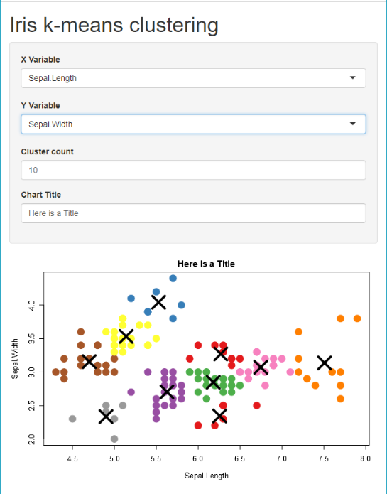
Practical
In Rstudio go to ‘6_Shiny/code/example_02.R’

Slide 65
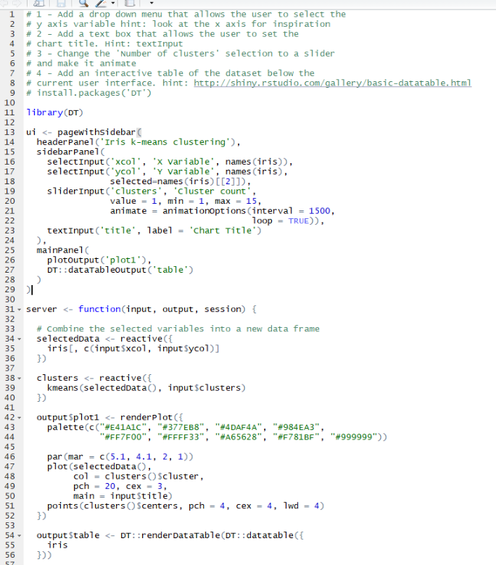
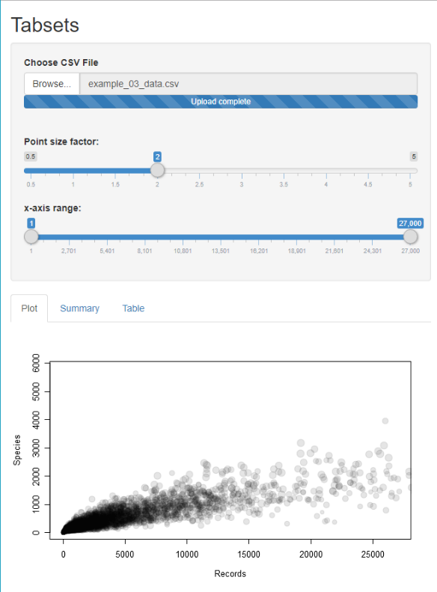
Practical
In Rstudio go to ‘6_Shiny/code/example_03.R’

Slide 66
Wrap-up
08

Slide 67
The internet is FULL of useful information
Karl Broman: https://kbroman.org/
Coding Club: https://ourcodingclub.github.io/
Rstudio tutorials: https://www.rstudio.com/online-learning/
Cheatsheets: https://www.rstudio.com/resources/cheatsheets/
Webinars: https://resources.rstudio.com/
A good book: https://github.com/christophergandrud/Rep-Res-Book
Data carpentry: https://datacarpentry.org/rr-workshop/

Slide 68
FEEDBACK
Please complete feedback on the Moodle before you leave

